Slide 1
The Writing Journey at Pearson Primary School

Slide 2
The 2014 National Curriculum for English aims to ensure that all pupils:
acquire a wide vocabulary, an understanding of grammar and knowledge of linguistic conventions for reading, writing and spoken language
write clearly, accurately and coherently, adapting their language and style in and for a range of contexts, purposes and audiences

Slide 3
At Pearson we aim to provide opportunities for children to write in response to real texts, and in response to real-life experiences. The programmes of study for writing at key stages 1 and 2 are constructed similarly to those for reading:
transcription (spelling and handwriting)
composition (articulating ideas and structuring them in speech and writing).
In addition, pupils are taught how to plan, edit and improve their writing. They are taught the language that they need to effectively evaluate their work, and that of others.

Slide 5
How can you help?
We are aware that a lot of children struggle to put their thoughts down onto paper. This is due to there being so much to think about:
What are my ideas?
How do I structure the words into a sentence?
How do I spell each word?
Can I use more interesting vocabulary?
How do I punctuate the sentence?
Does it make sense when I read it back?

Slide 6
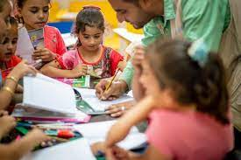
Follow your child’s interests.
Talk comes before writing.

Slide 7
Foundation Stage
Encourage your child to write their own name, family names, letter sounds and key words.
Explore writing with paint, chalk, misty windows etc...
Develop their gross motor skills in controlling their bodies with care, such as making circles with their arms.
Ask them to say and try to write simple sentences.

Slide 8
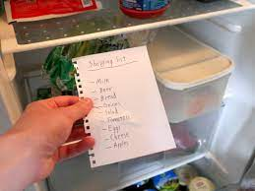
Key Stage 1
Encourage writing in play and what they do. For example: - lists for shopping, record the results for their favourite sports team.
Engage with their writing through: – saying what you liked in it. – asking where their ideas have come from? – asking them to show you where a sentence begins and ends.
Help them to organise and sequence their writing by asking them to talk about their ideas or to draw a sequence of simple pictures to show how the main events in a story might be organised.

Slide 9
Key Stage 2
Encourage their personal writing, for example; a journal or diary.
Talk through their ideas with them before they start to write, for example, prompt them to think about how they intend to tackle a subject.
Help them to reflect on their writing, particularly the effect they hoped to have on the reader, for example, is the reader sufficiently prepared for the ending?
Encourage them to read through their work, shaping their sentences for clarity and impact and checking their accuracy.

